Slide 1
COMMODITY PRICE PREDICTION :
BY:
ANISH KOTHARI(04)
VINEET SAJWAN(44)
MUKESH JHA (18)
SAURABH BARGE(08)
GUIDE :
MS. SWAPNIL SHRIVASTAVA

Slide 2
Commodity Price Prediction
Commodity :- Tuur
State :- Assam
Market:- Dibrugarh

Slide 3
PROBLEM STATEMENT
The problem we are going to look at in this project is the Commodity Price Prediction problem.
This is a problem where, a commodity name and price of the commodity for last five years per quintals for each is given, the task is to predict the Price of commodity for the very next day precisely. The data ranges from January 2012 to December 2017, or 5 years, with several missing observations.
The dataset is provided by the Centre of development of advanced computing (Bengaluru)

Slide 4
About the Dataset
Columns: The Data set contains 9 columns; The Initial 4 Columns are Commodity Name, State, District and
Market for that Commodity
Remaining 7 Columns are Arrival Date, Min_Price, Max_price, Modal_price, Arrival Quantity,Rainfall,Temp.
Size: The total Size of Data is around 50MB and it Contain prices of Commodity for last 5 Years
with Different market.
Dimensions: No of rows = 935522, No of columns = 16,Time Period = 2012 to 2017
Data Dictionary
1. Comm_name: Name of the Commodity, there are 5 Commodity in The Data
2. State: Describe the State for which prediction going to be done
3. District_name: Each state have several no of districts
4. Market_centre_name: Name of the market
5. Arrival_date: Date of arrival of commodity in that Market
6. MinPrice: Minimum price for which given commodity has been sold in the market
7. MaxPrice: Maximum price for which given commodity has been sold in the market
8. ModalPrice: Price between minimum and maximum price.
9. ArrivalQuantity: Amount of Quantity of commodity arrived in the market.
10. Rainfall : Record of the rain.
11. Temp: Daily recorded temperature.

Slide 5
Steps Followed
Data Preparation
Statistical Inference between variables
Preparing continuous data.
Applying forecasting and machine learning models for
Forecasting.

Slide 6
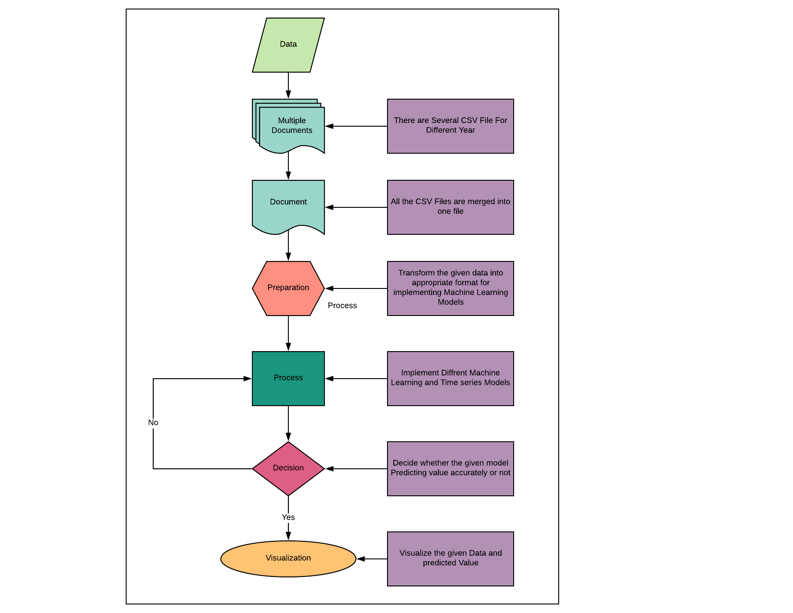
Flow Chart

Slide 7
Data Preparation
Collect the data from different files into one single file for a particular commodity and district.
Include temperature and rain fall data with the given data.
Play with the dates and change the formats of the column.
Make the data continuous for the better prediction and inference.

Slide 8
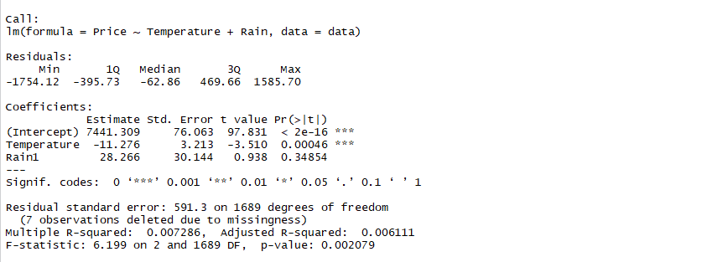
Statistical Inference (Step 1)

Slide 9
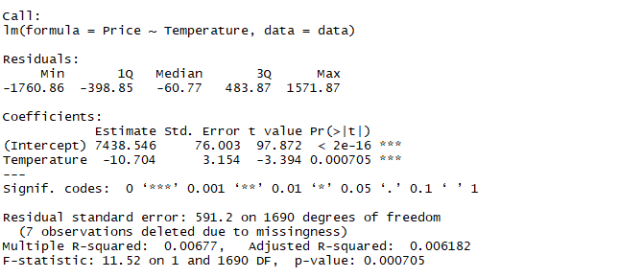
Statistical Inference (Step 2)

Slide 10
Insights
1.Continuous data make our data and forecasting more robust.
2.Temperature is negatively correlated with the price. To be precise, if the temperature is decreased by 1 unit the price will increase by 35 unit.
3.Rain doesn’t make any impact on the Price.

Slide 11
Auto Regressive Integrated Moving Average
The method used for forecasting is ARIMA
Auto Regressive Integrated Moving Average
which has Basically 3 parameters ARIMA(p,d,q)
p = order of autoregressive model
d = degree of differencing.
q = order of moving average model.
It is available in Forecast package of R.
And is highly Flexible for Any kind of Data Seasonal or Stationary
We used Auto.Arima function which chooses the Best Arima model according to the given data.ie which has least information Criteria.

Slide 12
Using auto.ARIMA () :
Returns best ARIMA model according to either AIC, AICc or BIC value. The function conducts a search over possible model within the order constraints provided.
Usage:
auto.arima(y, d = NA, D = NA, max.p = 5, max.q = 5, max.P = 2,
max.Q = 2, max.order = 5, max.d = 2, max.D = 1, start.p = 2,
start.q = 2, start.P = 1, start.Q = 1, stationary = FALSE,
seasonal = TRUE, ic = c("aicc", "aic", "bic"), stepwise = TRUE,
trace = FALSE, approximation = (length(x) > 150 | frequency(x) > 12),
truncate = NULL, xreg = NULL, test = c("kpss", "adf", "pp"),
seasonal.test = c("ocsb", "ch"), allowdrift = TRUE, allowmean = TRUE,
lambda = NULL, biasadj = FALSE, parallel = FALSE, num.cores = 2,
x = y, ...).

Slide 13
Why ARIMA ?
As Arima can be used for Seasonal as well as Non seasonal data .
Even though after making the Data Continuous the Data Was not Seasonal And hence as Arima uses integrated Moving Average , I choose to apply Arima Model.

Slide 14
Output of auto.arima :
Order of the auto - regressive Model = 0
Degree of Differencing = 1
Order of Moving Average Model = 0
AIC = 16431.98
AICc =16431.99
BIC = 16437.27

Slide 15
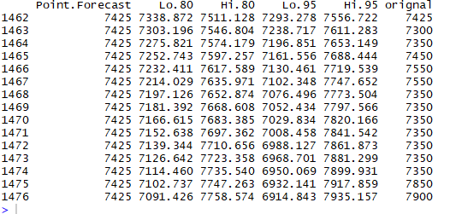
Arima predictions :

Slide 16

For monthly (avg) prediction
For weekly(avg) prediction :

Slide 17
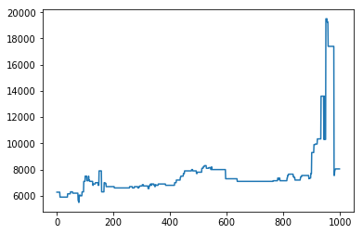
RNN DESCRIPTION
A powerful type of neural network designed to handle sequence dependence is called recurrent neural networks.
The Long Short-Term Memory network or LSTM network is a type of recurrent neural network used in deep learning because very large architectures can be successfully trained.

Slide 18
You can see an upward trend in the dataset over time. You can also see there is no periodicity to the dataset that probably corresponds time.
Long Short-Term Memory Network
1.) The Long Short-Term Memory network, or LSTM network, is a recurrent neural network that is trained using Backpropagation Through Time and overcomes the vanishing gradient problem.
2.) Instead of neurons, LSTM networks have memory blocks that are connected through layers.
3.) During this project we develop LSTM networks in Python using the Keras deep learning library to address a demonstration time-series prediction problem.

Slide 19
Loading the Dataset
We can load this dataset easily using the Pandas library.
We are not interested in the date, Because Recurrent Neural network doesn’t take date as parameter when we load the dataset we can exclude the date column.
Model Description
We can phrase the problem as a regression problem. That is, given the price of commodity this day, what is the price of commodity next day in that market?
We can write a simple function to convert our single column of data into a two-column dataset: the first column containing this day’s (t) commodity price and the second column containing next day’s (t+1) commodity price, to be predicted.

Slide 20
Before we do anything, it is a good idea to fix the random number seed to ensure our results are reproducible.
We can extract the NumPy array from the DataFrame and convert the integer values to floating point values, which are more suitable for modeling with a neural network.
LSTMs are sensitive to the scale of the input data, specifically when the sigmoid (default) or tanh activation functions are used. It can be a good practice to rescale the data to the range of 0-to-1, also called normalizing. We can easily normalize the dataset using the MinMaxScaler pre-processing class from the scikit-learn library.
Now create a New Dataframe Where dataset where X is the Price of commodity at a given time (t) and Y is the price of commodity at the next time (t + 1).

Slide 21
We are now ready to design and fit our LSTM network for this problem.
The network has a visible layer with 1 input, a hidden layer with 4 LSTM blocks or neurons, and an output layer that makes a single value prediction. The default sigmoid activation function is used for the LSTM blocks. The network is trained for 200 epochs and a batch size of 1 is used.
Once the model is fit, we can estimate the performance of the model on the train and test datasets. This will give us a point of comparison for new models.
Note that we invert the predictions before calculating error scores to ensure that performance is reported in the same units as the original.

Slide 22
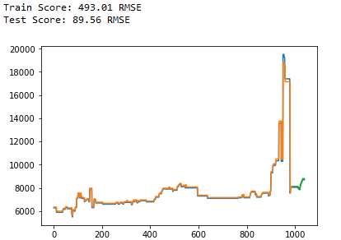
Finally, we can generate predictions using the model for both the train and test dataset to get a visual indication of the skill of the model.
Because of how the dataset was prepared, we must shift the predictions so that they align on the x-axis with the original dataset. Once prepared, the data is plotted, showing the original dataset in blue, the predictions for the training dataset in green, and the predictions on the unseen test dataset in Green.

Slide 23
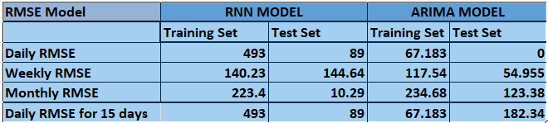
MODEL COMPARISON
By comparing both the models there is a common accuracy
Measure: RMSE (Root mean square error).

Slide 24
CONCLUSION
RNN model will be used for monthly price prediction.
For a single day and single week (AVG) price prediction ARIMA will be used.
Whereas for continuous Daily data prediction RNN is preferred.

Slide 25
Thank You

